Slide 1
Power BI Embedded
FSI CSU SWARM

Slide 2
Abstract and learning objectives
Abstract and learning objectives
Embed Power BI objects within applications

Slide 3
Preferred target audience
Main topic 1: size 36pt
Size 28pt for second level
Size 24pt for third level
Size 22pt for fourth level
Size 22pt for fifth level

Slide 4
Embedding Functionalities
Embedding Power BI Content | The Power BI service (SaaS) and the Power BI Embedded service in Azure (PaaS) have APIs for embedding your dashboards and reports. This feature means you can access the latest Power BI features – such as dashboards, gateways, and app workspaces – when embedding your content.

Slide 5
Introduction

Slide 6
Power BI Service
Provides cloud-based foundation for power BI platform
Accessible with browser through https://app.Powerbi.Com
Accessible through power BI mobile apps
Accessible to developers through power BI service API

Slide 7

Using the Power BI Service API
Accessible by making direct REST calls against service
Accessible by using assembly DLL that abstracts away REST calls
Assembly DLL is named microsoft.Powerbi.Api.Dll
Assembly DLL part of nuget package (microsoft.Powerbi.Api)
Calling service requires authentication with azure active directory

Slide 8
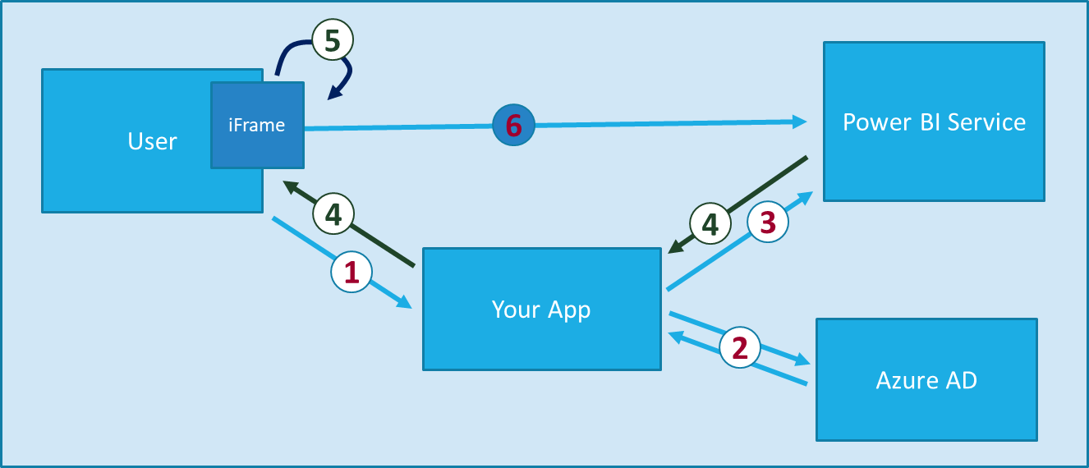
Power BI Embedding The Big Picture
User launches your app using a browser
App authenticates with azure active directory and obtains access token
App uses access token to call to power BI service API
App retrieves data for embedded resource and passes it to browser.
Client-side code uses power bi javascript api to create embedded resource
Embedded resource session created between browser and power BI service
Notes:
https://docs.microsoft.com/en-us/power-bi/developer/embedding

Slide 9
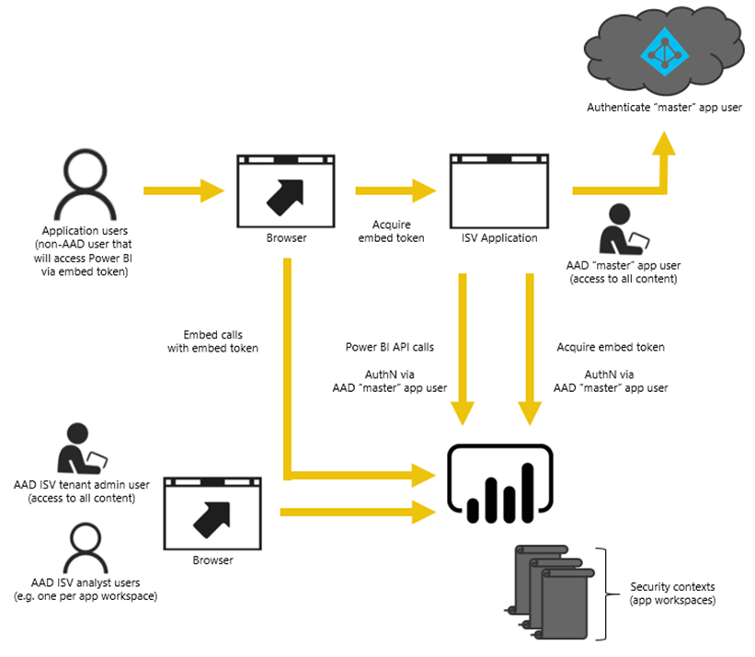
Power BI Embedding – The Big Picture
User launches your app using a browser
App authenticates with azure active directory and obtains access token
App uses access token to call to power BI service API
App retrieves data for embedded resource and passes it to browser.
Client-side code uses power bi javascript api to create embedded resource
Embedded resource session created between browser and power BI service

Slide 10
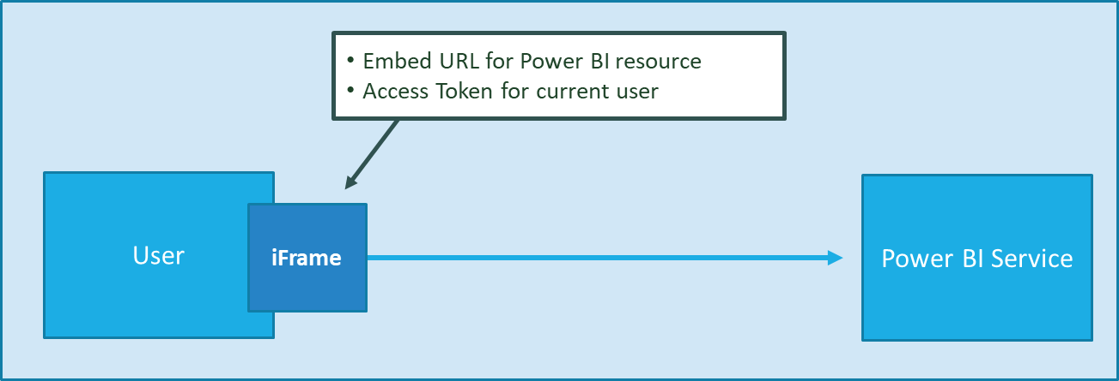
First Party Embedding
App authenticates current user with Azure AD
Your code accesses Power BI Service as current user
Embedding requires Azure AD access token for user
User requires Azure AD account and Power BI license
Your code has access to whatever user has access to

Slide 11
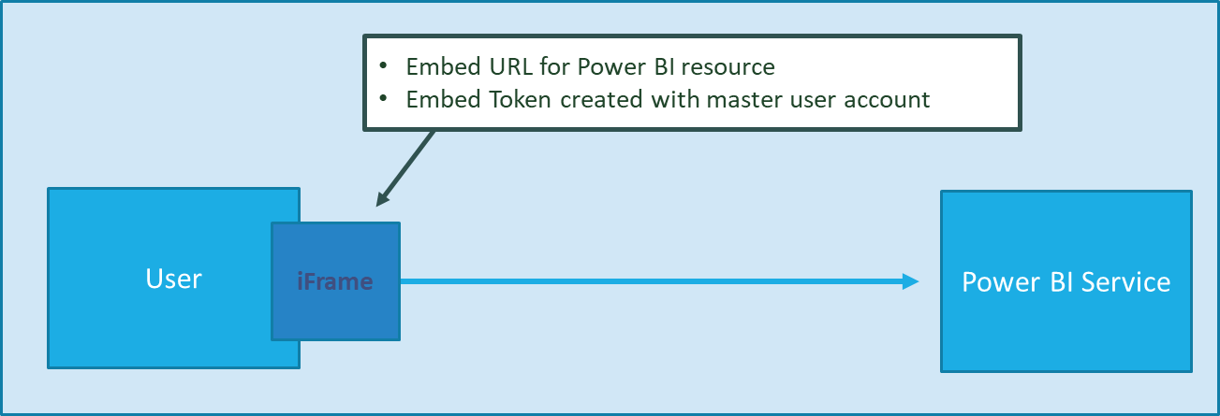
Third Party Embedding
App authenticates using Master User Account
Your code accesses Power BI Service as master user
Embedding uses embed token instead of access token
Users don’t need AAD accounts and Power BI licenses
Your code has access to whatever master has access to

Slide 12
First Party vs Third Party Embedding
What scenarios use first party embedding?
What scenarios use third party embedding?
Organizations where users have Power BI licenses
Embedding Power BI reports in SharePoint and Teams
Development should go beyond out-of-box experience
Scenarios where users don’t have Power BI licenses
Applications which have custom identity providers
Applications which use identity provider other than AAD

Slide 13
First Party vs Third Party Embedding Cont…
 | 1st Part Embedding | 3rd Party Embedding
Authentication flow | Authentication Code Grant Flow or Implicit Flow | Direct User Credentials
Identity used to call Power BI | Current User | Master User Account
Access to personal workspace | Yes | No
Access to app workspaces | Yes | Yes
Ability to reach non-licensed users | No | Yes
Supported Power BI Capacity SKUs | P* and EM* SKUs | P*, EM* and A* SKUs

Slide 14
Use Cases

Slide 15
Step 1: Review the customer case study
Outcome
Analyze your customer needs
Timeframe
15 minutes

Slide 16
Customer situation
Main topic 1: size 36pt
Size 28pt for second level
Size 24pt for third level
Size 22pt for fourth level
Size 22pt for fifth level

Slide 17
Customer needs
Main topic 1: size 36pt
Size 28pt for second level
Size 24pt for third level
Size 22pt for fourth level
Size 22pt for fifth level

Slide 18
Customer objections
Main topic 1: size 36pt
Size 28pt for second level
Size 24pt for third level
Size 22pt for fourth level
Size 22pt for fifth level

Slide 19
Common scenarios
Main topic 1: size 36pt
Size 28pt for second level
Size 24pt for third level
Size 22pt for fourth level
Size 22pt for fifth level

Slide 20
Hands-On Module

Slide 21
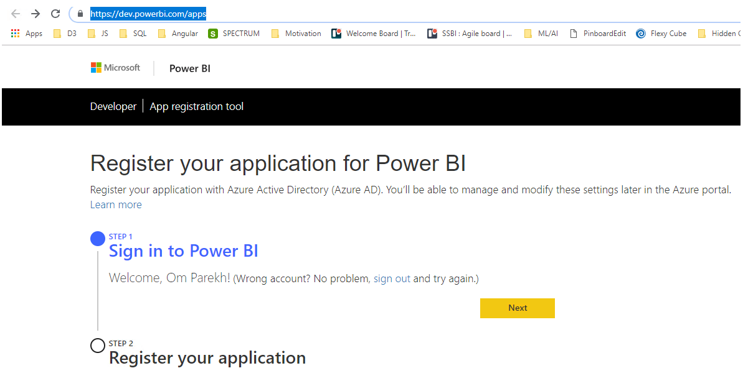
Registered your app for Power BI
Open below URL and Sign-in using Power BI Pro credentials
https://dev.powerbi.com/apps

Slide 22
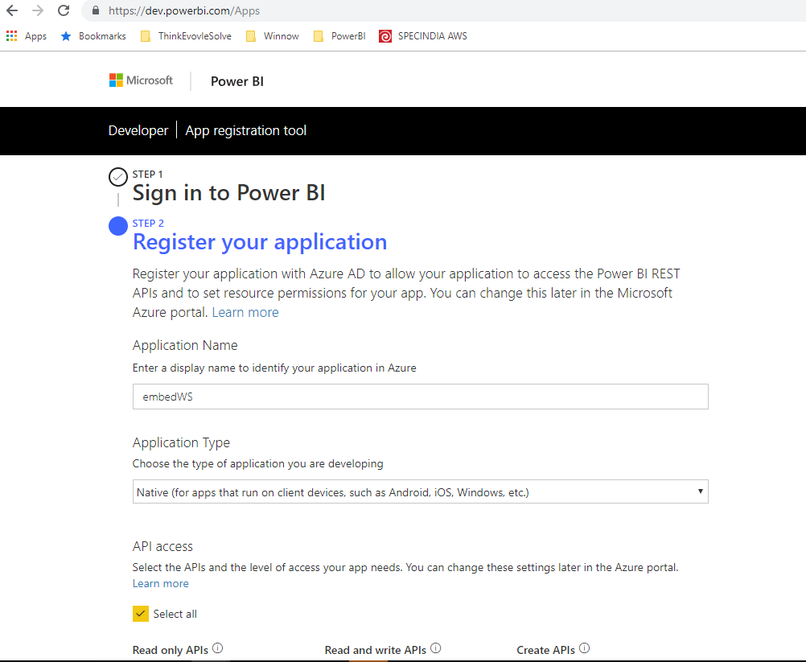
Registered your app for Power BI
Registered App (Step 2)
Please remember Application name, Client Id
Example Client ID : 7114bf2f-8aad-49ad-8a7c-2e80e9b6fbba

Slide 23
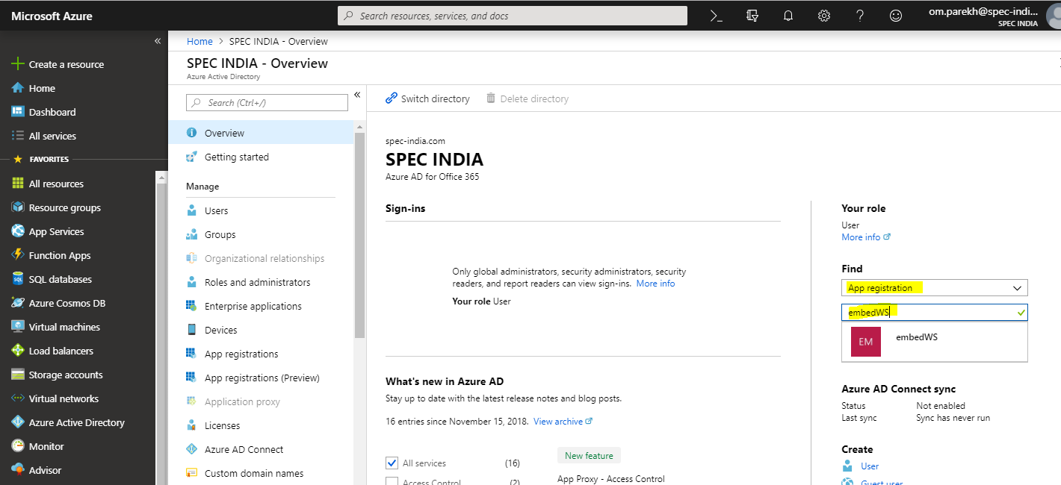
Registered your app for Power BI
Open Azure portal using the same Power BI Pro account and registered your app (Azure Active Directory)
Goto Setting -> Required Permission -> Grant Permission (select All)

Slide 24
Power BI
Go to Power BI App (app.powerbi.com)

Slide 25
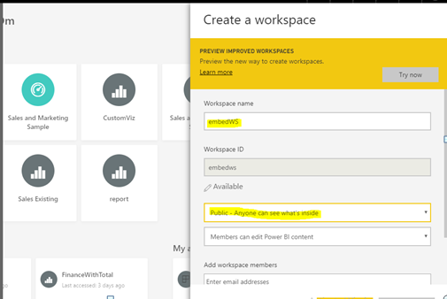
Power BI
Create Workspace
Note : Workspace name should match with application name we defined in azure portal.

Slide 26
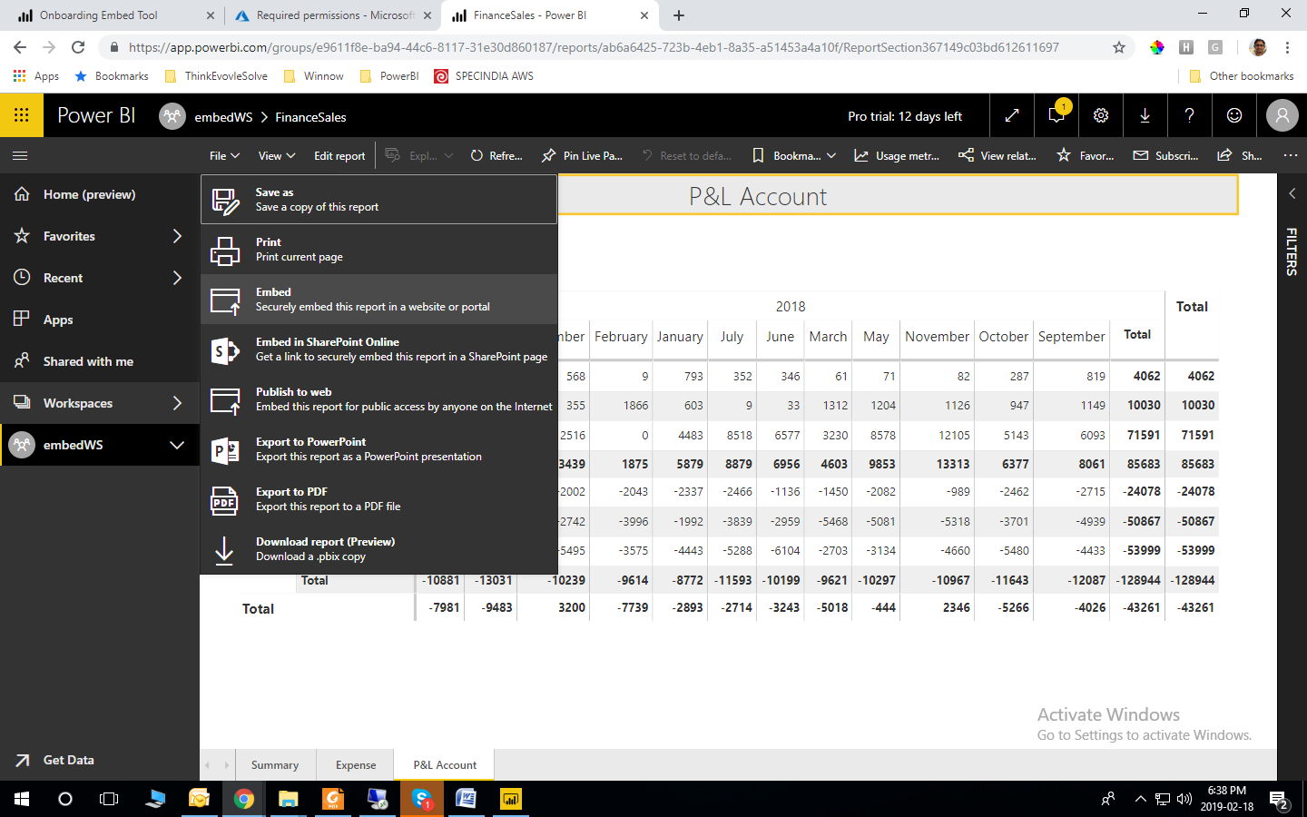
Power BI
Published the Power BI report in workspace we just created in above steps.
Open Power BI Report and click on File->Embed

Slide 27
Power BI
Copy URL from the popup window.
Embed URL : https://app.powerbi.com/reportEmbed?reportId=ab6a6425-723b-4eb1-8a35-a51453a4a10f&groupId=e9611f8e-ba94-44c6-8117-31e30d860187
Report Id = ab6a6425-723b-4eb1-8a35-a51453a4a10f
Group Id = e9611f8e-ba94-44c6-8117-31e30d860187
Please note embed url, group id and report id

Slide 28
REST API
Call REST API to open power BI report securely

Slide 29
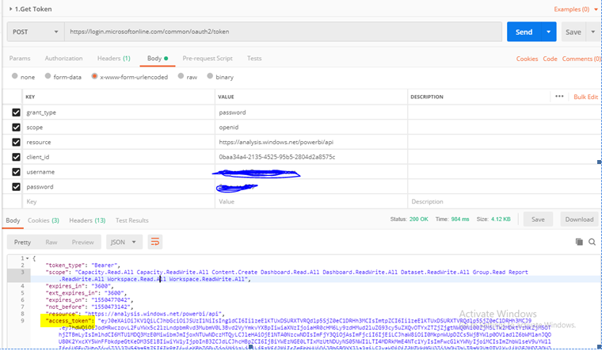
REST API Part
Call GetTocken REST API with header and body
https://login.microsoftonline.com/common/oauth2/token
Header
Content-Type = application/x-www-form-urlencoded
Remember Access Token from result

Slide 30
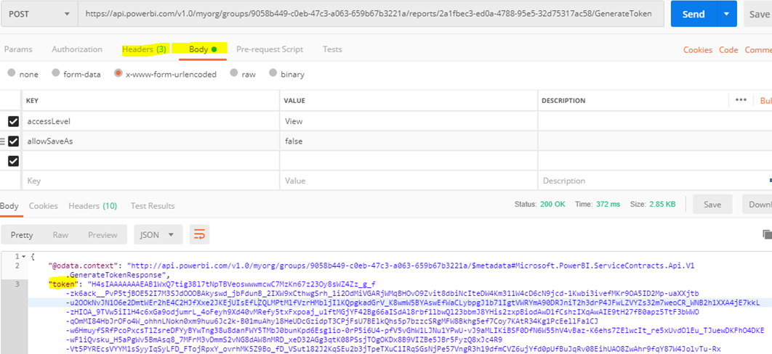
REST API Part
Generate embed token using below REST API
https://api.powerbi.com/v1.0/myorg/groups/<<GROUP ID>>/reports/<<REPORT ID>>/GenerateToken
Header
Authorization = Bearer <<Access Tocken>>
Content-Type = application/x-www-form-urlencoded
Accept=application/json
BODY
accessLevel = View
allowSaveAs=false
Remember Token from result [it is embed token]

Slide 31
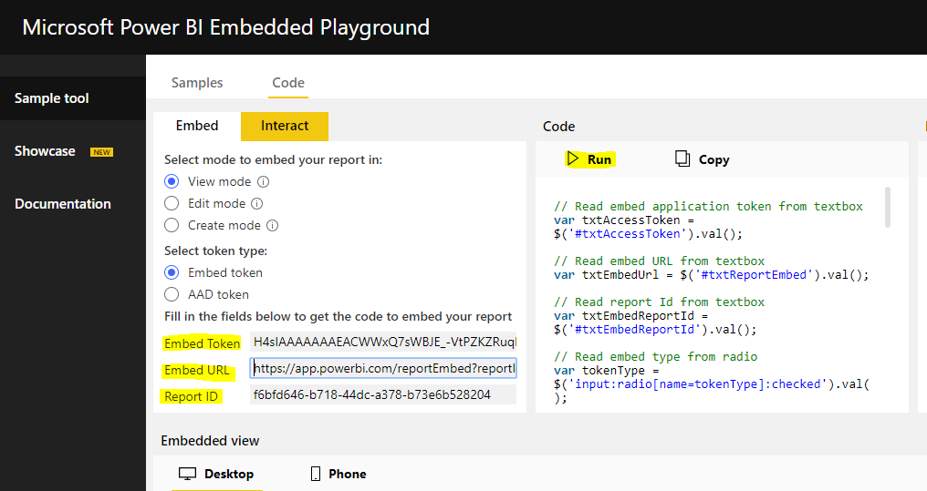
Attached Power BI Report in App
We have following items
Embed Token
Report Id
Group Id
Call Power BI Report using Microsoft Utilities
https://microsoft.github.io/PowerBI-JavaScript/demo/v2-demo/index.html

Slide 32
Wrap Up

Slide 33
Wrap-up
Outcome
Identify the preferred solution for the case study
Identify solutions designed by other teams
Timeframe
15 minutes

Slide 35
Text layout (without bullet points)
Main topic 1: size 36pt
Size 28pt for second level
Size 24pt for third level
Size 22pt for fourth level
Size 22 for fifth level

Slide 36
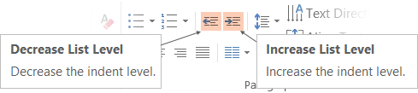
Text with bullet points - adjusting list levels
Main topic 1: size 36pt
Size 28pt for second level
Size 24pt for third level
Size 22pt for fourth level
Size 22 for fifth level
Use the “Decrease List Level” and “Increase List Level” tools on the Home Menu to change text levels.
Try this:
Place your cursor in any row of text to the left that says “Size 20pt for subtopics”
Next click the Home tab, and then on the “Decrease List level” tool. Notice how the line moves up one level.
Now try placing your cursor in one of the “Main topic…” lines of text. Click the “Increase List Level” tool and see how the text is pushed in one level
Use these 2 tools to adjust your text levels as you work

Slide 37
Bullet points layout with subtitle Subtitle is smaller in the same text block
Example of a bulleted slide with a subhead
Set the slide title to “Sentence case”
Set subheads to “Sentence case”
Hyperlink style
www.microsoft.com

Slide 38
Photo layout 1

Slide 39
Demo

Slide 40
Video

Slide 41
Software code slide
This slide layout uses Consolas, a monotype font which is ideal for showing software code.

